Slide 1

3 Types of Resumes

Slide 2
Three Types of Resumes
Choosing the best resume format is extremely important because there are many factors to take into account.
These include the length of your resume and your accomplishments, as well as possible shortcomings.
Whichever resume format you choose, make sure to include examples of accomplishments that benefited your previous employers.
Three common types of resumes are chronological, functional and combination (skills-based).
Keep in mind that businesses prefer either a chronological resume or a combination resume.

Slide 3
Chronological Resume Style
Chronological resumes highlight consistency.
This format stresses what you accomplished in each of the positions you held.
A chronological resume focuses primarily on the history of your work experience and education.
It also shows your progress and advancements in your career.
This resume format is popular among businesses.

Slide 4
Functional Resume Style
A functional resume focuses on your skills and experience, without including chronological time and job titles.
It presents a profile of your experience based on professional strengths or groups of skills.
Your work history usually follows, but in less detail than in a chronological resume.
It is used most often by people with gaps in their work history, those who are changing careers and individuals with limited work experience.
Employers generally do not prefer to receive functional resumes as they do not show your work history or career progress.

Slide 5
Combination Resume Style
A combination (or combined) resume combines the best features of the traditional chronological (where the dates are in reverse order) and functional (where skills are listed in the beginning) resumes.
A combination resume can also be referred to as a skills-based resume.

Slide 6
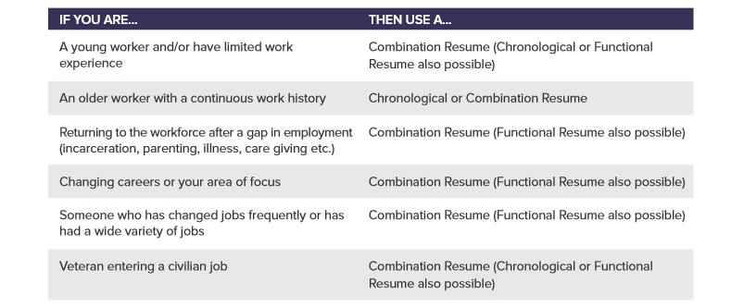
CHOOSING YOUR RESUME TYPE

Slide 7
No matter what resume format you choose, an effective resume is targeted and tailored so that it does the following:
Addresses a business’s specific needs and shows that you are the best fit for the position.
Focuses on a specific career objective or job posting within the first 15 lines of your resume.
States your value as an employee with results that you produced that benefited your previous employers.
Allows employers to easily and quickly read it.

Slide 8

For additional information or to build a resume online, go to: www.jobzone.ny.gov

