Slide 1

Action Verbs to Use in a Resume
Action verbs describe what you did at your job.
Remember to use these verbs to describe your work experience when writing your resume and drafting cover letters.
This will increase the impact of your writing and make potential employers take notice!

Slide 2
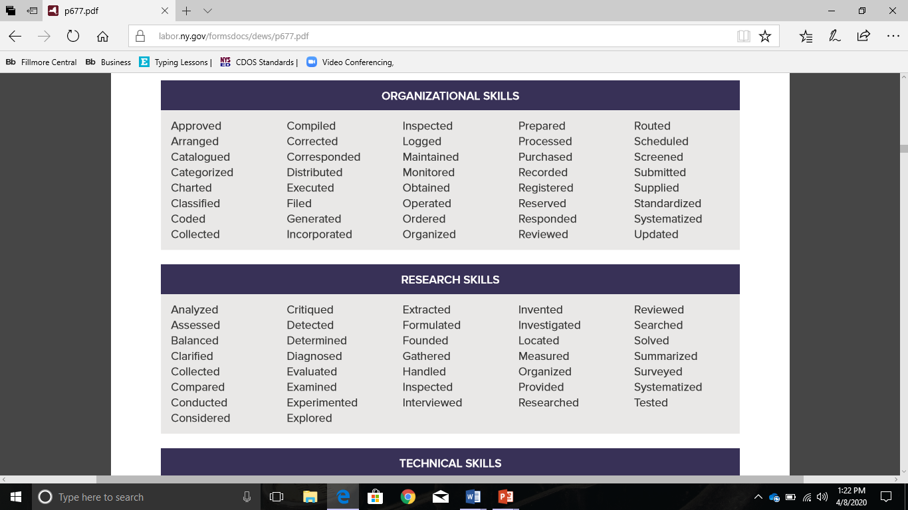
Organizational Skills

Slide 3
Research Skills

Slide 4
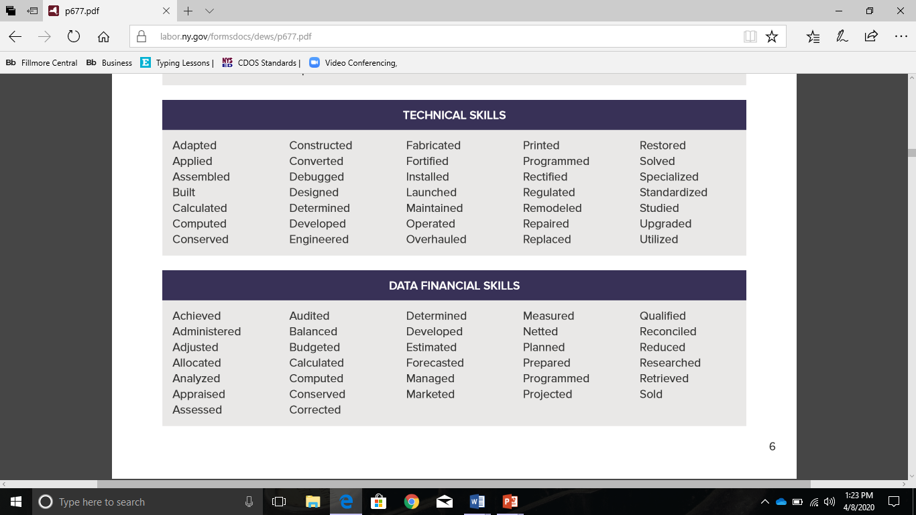
Technical Skills

Slide 5
Data/Financial Skills

Slide 6
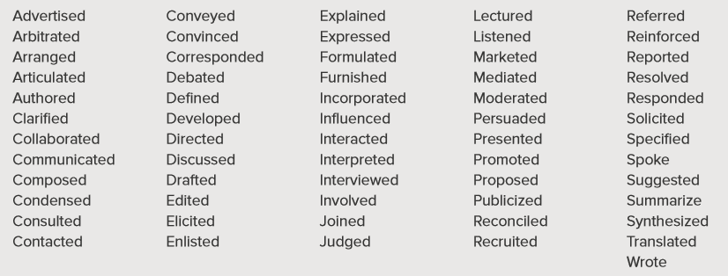
Communication/People Skills

Slide 7
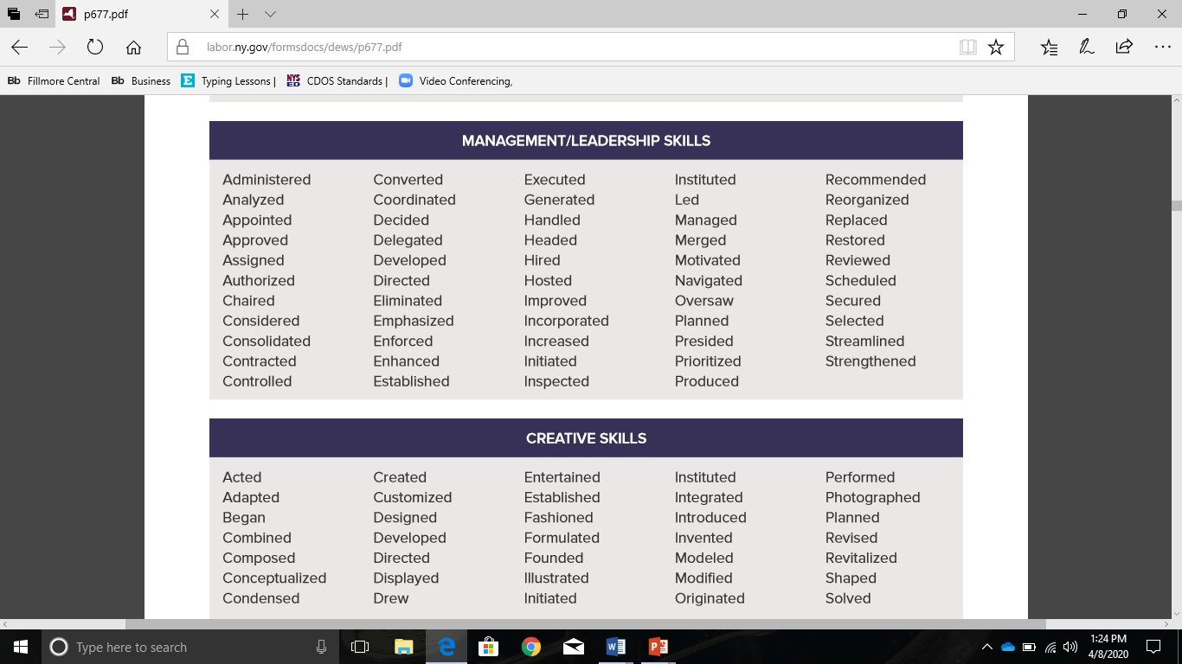
Management Leadership Skills

Slide 8
Creative Skills

Slide 9
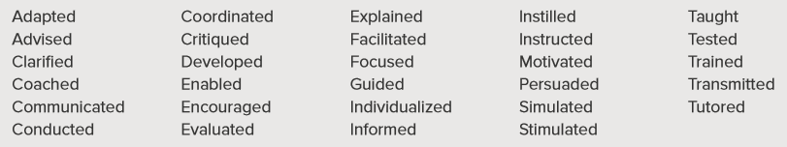
Teaching Skills

