Slide 1
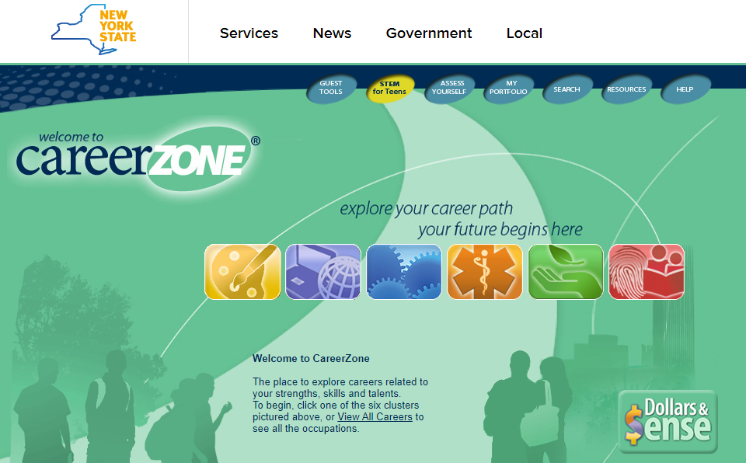
Careerzone.ny.gov

Slide 2
My Portfolio

Slide 3
Click on My Portfolio

Slide 4
Create an Account

Slide 5
Account Info Tab
Suggested password
eagles1

Slide 6
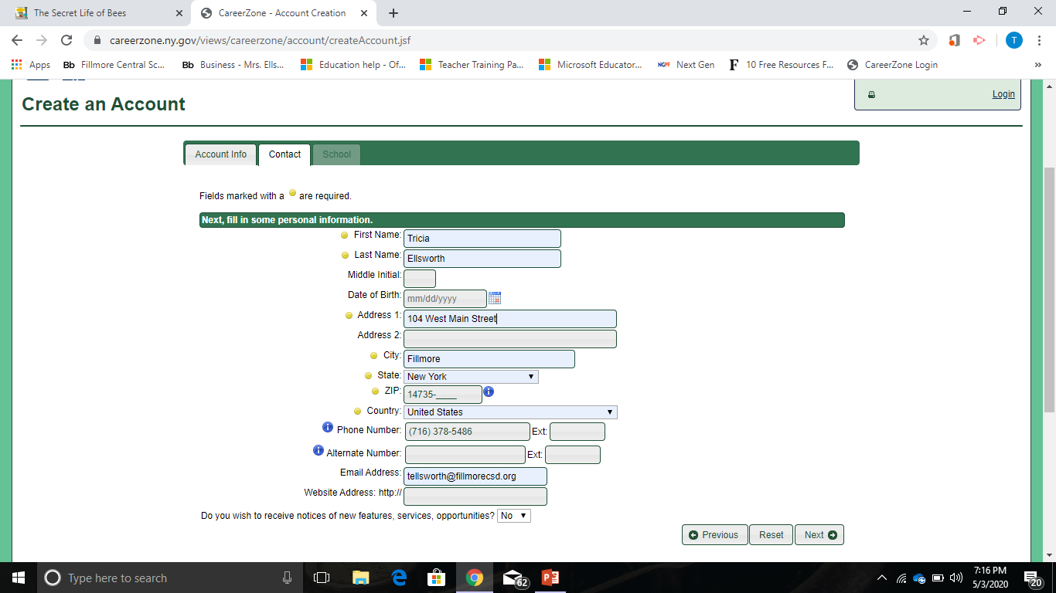
Contact Tab
Only fill out required information.
Annotated with a yellow bullet.
Do not use your mailing address.
Use the FCS Address.
104 West Main Street
Fillmore, NY 14735
585-567-2251
Once done,
Click next

Slide 7
School Tab
Portfolio Level
Tenth Grade
School/Organization
Fillmore Central School
School District
Fillmore Central School
Then, click Create Account

Slide 8
Welcome to Career Zone Portfolio

Slide 9
Welcome to CareerZone Portfolio
If you are seeing this page, then you have successfully registered for the CareerZone portfolio system.
Before we begin, we would like to give you a quick introduction to what you can expect from the portfolio.
The next time you log in to the portfolio you will go straight in, so please take a moment to read this before you continue.

Slide 10
What is a portfolio?
A portfolio is a way of documenting your achievements in a specific field.
They are a way of proving that you can do the things you say you can.
Portfolios may include samples of your work, assessment scores, or other evidence of your abilities.
The two main types are Job portfolios and Learning portfolios.
As you might guess from the names, Job portfolios focus on your work history and are designed to help you get or advance within a job, while Learning portfolios focus on your abilities as a student.

Slide 11
The CareerZone Portfolio
Career Zone Portfolio is primarily a learning portfolio, but we also pull in features commonly found in a Job portfolio.
In this way we develop what we like to consider a Career portfolio.
A Career portfolio helps you combine a Learning portfolio with the best features of a Job portfolio, and points out how the things you’ve learned as a student relates to the work of work.

Slide 12
On the following pages you’ll find many activities designed to help you understand why your education is so important now, and give you ideas of how to use it in the future.
We needed some personal information from you to register you in the system, but we won’t share it with anyone without your permission.
As a CareerZone portfolio user, only people who know your password will have access to your portfolio; so do not share it with anyone and keep it in a safe place.
For more information about the information you enter in the portfolio, you can check out our privacy statement.
Click the Login button below to access all the features of the CareerZone system.
Please note: if you do not login for a period of 455 days, your account may no longer be available.

Slide 13
Click “OK”

Slide 14
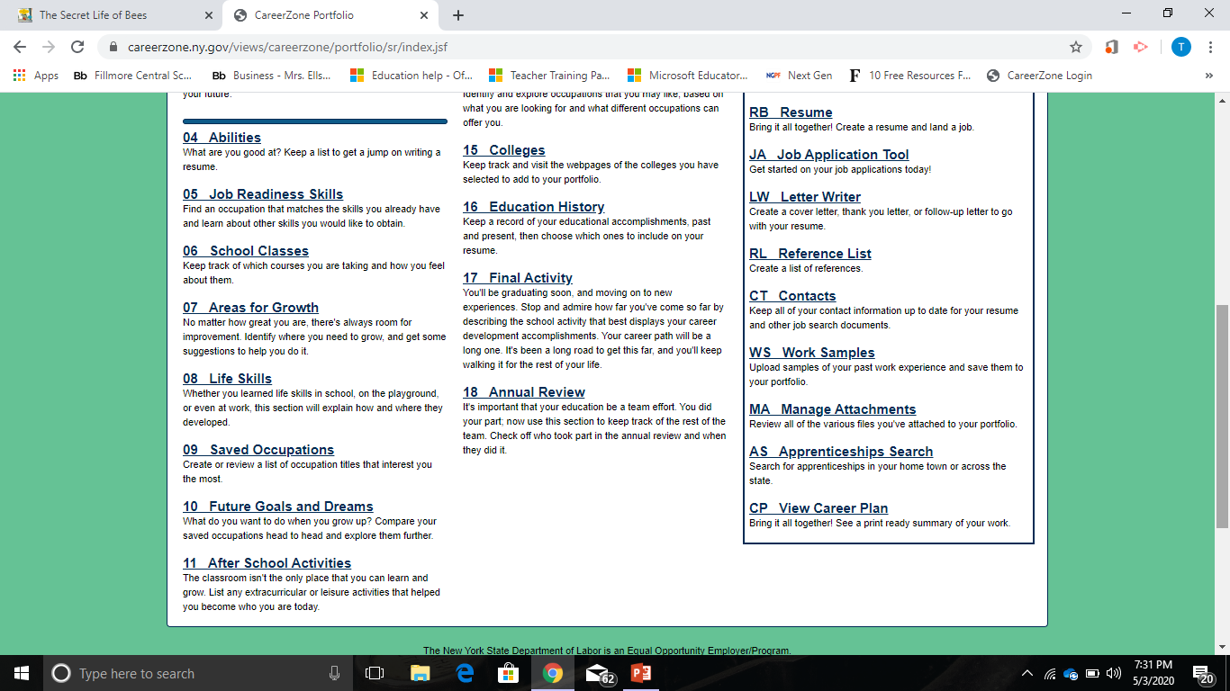
Now you can access your own Portfolio

