Slide 1

What are Transferrable Skills?

Slide 2
Transferable Skills
Universal skills that you can easily take with you from one business or job to another.
They are skills you have used in the past that may relate to future jobs.
Jobseekers often feel they must look for the same job or title they last held.
This puts limits on the types of jobs you look for.
By identifying your transferable skills, you will open up more job opportunities.

Slide 3
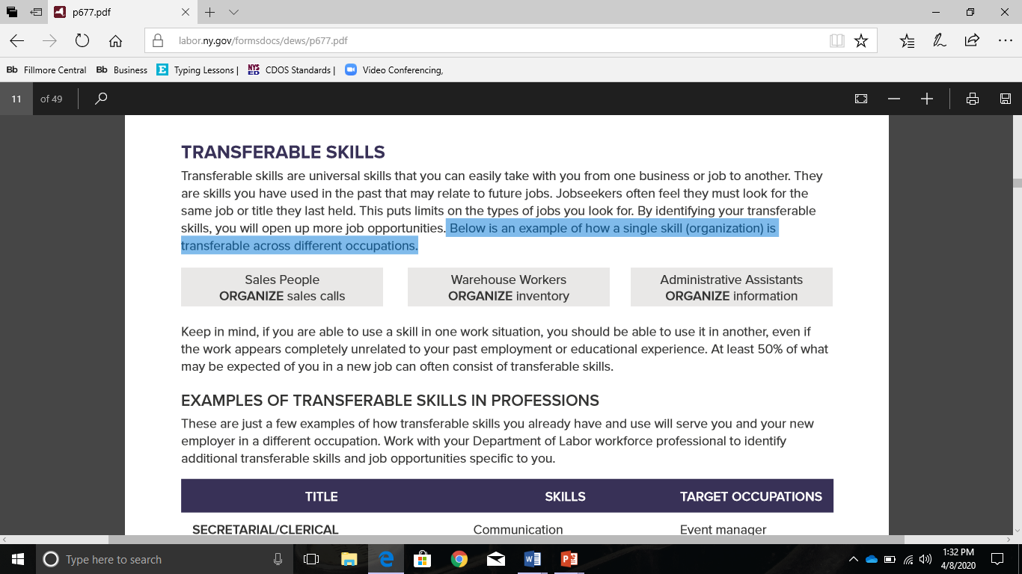
Here is an example of how the single skill, organization, is transferable across different occupations.
If you are able to use a skill in one work situation
    you should be able to use it in another
    even if the work appears completely unrelated to your past employment or educational experience.
At least 50% of what may be expected of you in a new job can often consist of transferable skills.

Slide 4
Secretarial/Clerical
Title | Skills | Target Occupations
Helen has 15 years of experience in a job with diverse tasks. She is skilled at answering multi-line phone systems, greeting customers, typing correspondence, and transcribing in minutes. She uses the latest computer system for correspondence and databases. She also maintains electronic appointment books, prepares materials for meetings, orders office supplies, and makes travel plans. | Communication Customer service Active listening Organization Management of multiple projects Attention to details Prioritize tasks Time management | Events Manager Purchasing agent Manage repair or service calls Customer service Intake worker in human service or medical field Insurance clerk

Slide 5
Material Handler/Laborer
Title | Skills | Target Occupations
Joseph is a worker who uses his physical strength all day to move heavy objects. In his job, he needs to detect product problems by visual inspection. He fixes these problems by using hand and power tools. It is important that he is punctual, follows safety procedures, and meets production levels. | Knowledge of how to use hand and power tools for repair Understanding of how materials are assembled Plan when storing or loading materials | Assistant carpenter Shipping and receiving clerk Delivery person Moving and storage worker

Slide 6
Retail Salesperson
Title | Skills | Target Occupations
Joan worked for 10 years as a cashier in one organization, achieving a high salary for her skills. She has knowledge of many functions of the retail business because she floated among several departments over the years. Joan’s co-workers often praise her for her ability to step in during tense situations and calm people down | Customer service High accuracy and ability to learn new information Relaying information to others | Customer service Insurance agent Receptionist Banker or Teller Outside or inside sales

Slide 7
More on Transferable Skills

